Slide 1
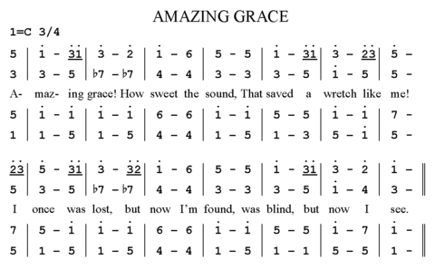
Numbered Musical Notation
A notation system mainly used by China

Slide 2
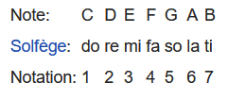
Notation: Pitch
Moveable Do System
Key must be specified
Dot notation to signify octaves
Can stack dots
Not meant for piano score going from A0 to C8
Western accidentals still used

Slide 3
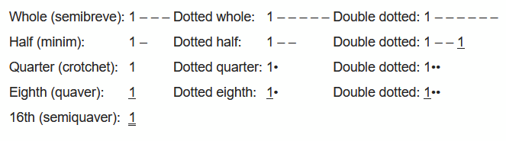
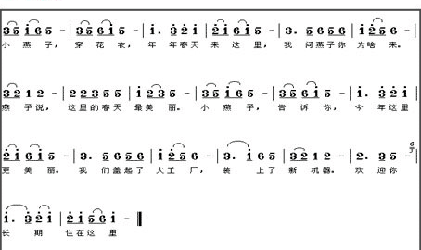
Notation: Time
“0” as a rest
Time signature placed at top of score

Slide 4
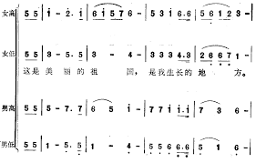
Notation: Parts and Voices
Similar to our western scores
Does not have barline go through each part
Tries to match times up with each part
This is a part distribution for Female low/high
and Male low high

Slide 5
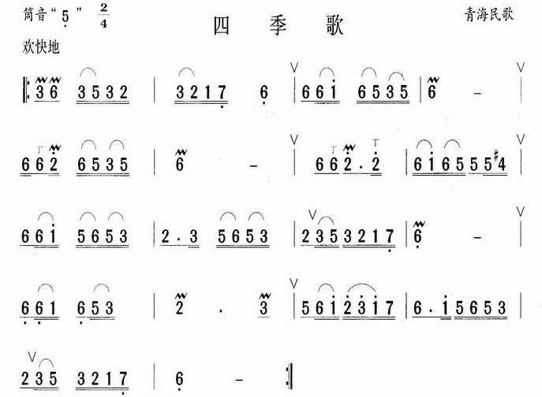
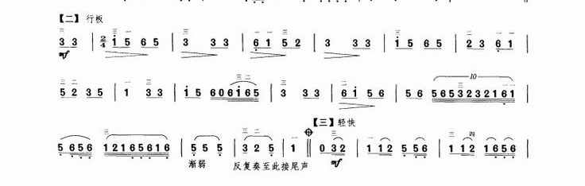
Notation: Expression
Staccato incredibly hard to notate - bolder dot or inverted triangle
Slurs marked similarly to Western
Dynamics are marked beneath note
Other western symbols used

Slide 6
Representation in Code
Can be done either in streams or in objects
Objects might be better because:
Each musical symbol has a specific length and the length is not as apparent within the notation as it is in western notation
Each onset has a specific quality
Streams might be better because:
When representing multiple parts, the notes usually do not line up based on the representation of time using lines and dots

Slide 7
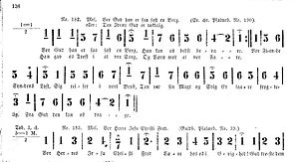
Other notes
Very singer based
Lilypond has a converter from Number Notation
See Siffernotskrift - Scandinavia

